Slide 1
EDU ISV Hackathon
Azure Overview
Questions: alias@microsoft.com

Slide 2
Agenda
What is Azure?
What can I build?
How do partners benefit?

Slide 3
The Microsoft Intelligent Cloud
Secure Enterprise
Operations Management
Security
Cortana Intelligence Suite
Office 365
Dynamics
Azure
PRODUCTIVITY
BUSINESS APPS
SECURITY & MANAGEMENT
DATA & INTELLIGENCE
APPLICATION INNOVATION
Notes:
“Azure” is a pillar in the collection of the Microsoft Intelligent cloud.

Slide 4

Azure is … BIG
57%
30 trillion
of Fortune 500 companies
objects stored
300 million
4,200 per person on Earth
Azure AD users
13 billion
3 million
authentications per week
requests per second
300k
active websites
Notes:
Azure is big, and getting bigger. Fear of cloud is no longer justified. Azure is good enough for more than half of the Fortune 500, including financial companies, and it's good enough for your school.
Over 1 billion customers, 20 million businesses, 76 markets worldwide
280 years of combined industry experience in infrastructure, security, product dev, and global ops

Slide 5

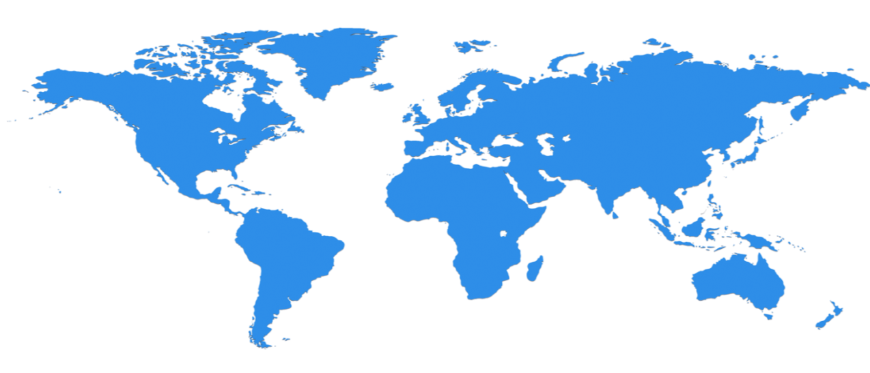

Azure is … everywhere
28 Regions Worldwide, 22 ONLINE…huge capacity around the world…growing every year
North Central US
Illinois
United Kingdom
Regions
West Europe
Netherlands
Central US
Iowa
Canada Central
Toronto
Canada East
Quebec City
Germany North East **
Magdeburg
China North *
Beijing
US Gov
Iowa
North Europe
Ireland
Germany Central **
Frankfurt
China South *
Shanghai
Japan East
Tokyo, Saitama
West US
California
East US
Virginia
India Central
Pune
Japan West
Osaka
South Central US
Texas
East US 2
Virginia
US Gov
Virginia
India South
Chennai
India West
Mumbai
East Asia
Hong Kong
SE Asia
Singapore
Australia East
New South Wales
40
Regions
Brazil South
Sao Paulo State
Australia South East
Victoria
South Africa
New
Over 1M+ production servers Dark fiber network 24 x 7 x 365 support
Notes:
Once they stood in the data center, that’s when it hit them. Once Vincent Capezuto, CTO for Aireon, stood in the data center and saw the massive size of an Azure data center, he understood the massive scale opportunity, one that he wanted to leverage. His next question was even more telling: “How many of these data centers do you have?”
This is SUCH a big investment – it’s a game for only very few. It’s not new for us – we have been doing this for our own services and our consumer/web properties for 20+ years. We continue to innovate, with high efficiency solutions, and at this scale it enables us to reduce our operating cost and reduce the cost of our services.
We will be in the major places, but not everywhere – we have Azure Stack/Hosters for that.
Data centers are now distributed all around the world and more are being planned and built. Geo-redundancy for critical data and disaster recovery is available.
Current datacenter locations:
US East, East 2 Virginia
US West California
US North Central Illinois
US South Central Texas
US Central Iowa
Europe North Ireland
Europe West Netherlands
Asia Pacific Southeast Singapore
Asia Pacific East Hong Kong
Japan East Saitama Prefecture
Japan West Osaka Prefecture
Brazil South Sao Paulo State
*Plans for 2 new regions in Australia have been publicly announced for ‘14
Go here to check individual component availability by datacenter. If a service is not available in a particular datacenter, such as mobile services in US North Central, you can still use the service from a nearby datacenter if you’re willing to deal with the increased latency and data crossing country borders.

Slide 6

Notes:
Microsoft Data center tour video from YouTube – REQUIRES AUDIO (4:55)

Slide 7
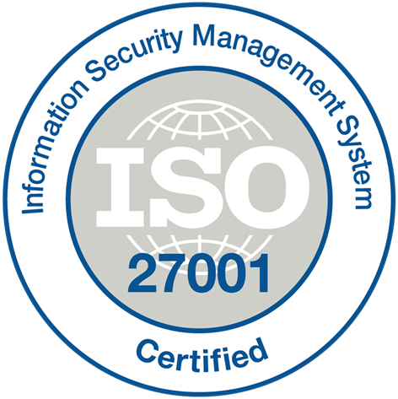



























Azure is … compliant
Industry
ISO 27001
SOC 1 Type 2
SOC 2 Type 2
PCI DSS Level 1
Cloud Controls Matrix
ISO 27018
Content Delivery and Security Association
Shared
Assessments
United
States
FedRAMP JAB P-ATO
HIPAA / HITECH
FIPS 140-2
21 CFR
Part 11
FERPA
DISA Level 2
CJIS
IRS 1075
ITAR-ready
Section 508 VPAT
Regional
European Union
Model Clauses
EU Safe Harbor
United Kingdom
G-Cloud
China Multi
Layer Protection Scheme
China
GB 18030
China
CCCPPF
Singapore
MTCS Level 3
Australian Signals
Directorate
New
Zealand
GCIO
Japan
Financial Services
ENISA
IAF

Slide 8


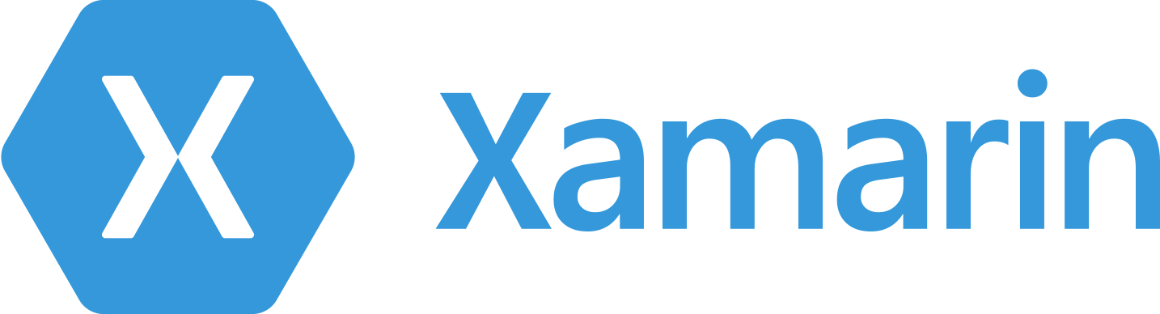
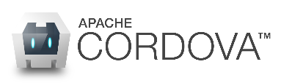

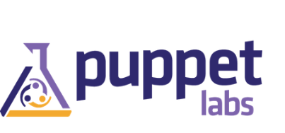

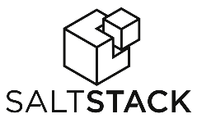









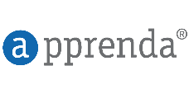
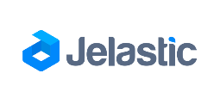
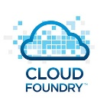

















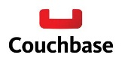




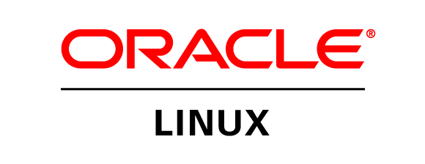
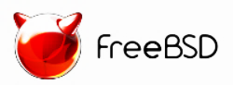

Azure is … open
DevOps
Clients
Management
Applications
PaaS and
DevOps
App frameworks
and tools
Databases and
middleware
Infrastructure
Notes:
1 out 3 of VMs on azure are Linux based;
Broadest selection of operating systems, programming languages, frameworks, tools, databases and devices. Run Linux containers with Docker integration; build apps with JavaScript, Python, .NET, PHP, Java and Node.js; build back-ends for iOS, Android and Windows devices.
IT folks can run everything, and enable developers with all technologies they desire to use

Slide 9
Azure is … flexible
Traditional
on-premises
Infrastructure
(as a Service)
Platform
(as a Service)
Software
(as a Service)
Applications
Applications
Applications
Applications
You manage
Data
Data
Data
Data
Runtime
You manage
Runtime
Runtime
Runtime
Middleware
Middleware
Middleware
Middleware
You manage
O/S
O/S
O/S
Managed by vendor
O/S
Virtualization
Virtualization
Managed by vendor
Virtualization
Virtualization
Servers
Servers
Servers
Servers
Managed by vendor
Storage
Storage
Storage
Storage
Networking
Networking
Networking
Networking
Notes:
Azure also provides infrastructure services which allow for more hands on configuration and management similar the servers you have today. However, they’re hosted in Microsoft datacenters letting you use Azure as if you were operating your own datacenter in the Cloud. For example, you can provision VMs, give them private IP addresses, and connect to them using a VPN from your on-premises environment. Most importantly, this lets Windows Azure mimic your on-premises datacenter and run your current apps with little or no change without the expense of having to own servers of racks, cooling and building costs. Furthermore, you can connect the “datacenter” you build in the Cloud to your on-premises datacenter so the datacenter in the Cloud becomes an extension to your on-premises infrastructure.
These “building blocks” lets Azure to be used as an Infrastructure-a- a-service.
So, you see Azure offers IaaS +PaaS in one platform. IaaS provides flexibility, PaaS eliminates complexity. Use PaaS where you can, use IaaS where you need. With Azure, you can use both together or independently, and build apps of the future. That uniquely differentiates us.
When to use? For whom?
2. IaaS is for current investments, and future-proofing, current market dynamics, why we did IaaS
(Lock in)
Saving tons of money
Forced to
Higher Agility
Here is your transition your work (Business Enabler, changes), optimize services, value to the business is much greater (IT Pro)
Infrastructure as a Service:
Control, flexibility, familiarity
Existing apps
Starting point; On-ramp to public cloud
4. Platform as a Service
More benefits (cost, scale, speed)
Differentiation
New app development
Cloud-native apps

Slide 10
































































Platform Services
Security & Management
Hybrid
Cloud
Media & CDN
Application Platform
Data
Security Center
SQL
Database
Azure AD
Health Monitoring
Media Services
Media Analytics
Content Delivery
Network
Web
Apps
Mobile
Apps
SQL Data
Warehouse
DocumentDB
Portal
AD Privileged
Identity
Management
Azure Active
Directory
Integration
SQL Server
Stretch Database
Redis
Cache
Storage
Tables
Azure
Search
API
Apps
Cloud
Services
Azure AD
B2C
API
Management
BizTalk
Services
Intelligence
Domain Services
Service
Fabric
Notification
Hubs
Multi-Factor
Authentication
Logic
Apps
Service Bus
Functions
Cognitive Services
Bot Framework
Cortana
Backup
Automation
Developer Services
Analytics & IoT
Operational
Analytics
Compute Services
Scheduler
HDInsight
Machine
Learning
Stream Analytics
Container
Service
VM
Scale Sets
Visual Studio
Mobile
Engagement
Import/Export
Key Vault
Data
Catalog
Data Lake
Analytics Service
Data Lake Store
Store/
Marketplace
Batch
RemoteApp
VS Team Services
Xamarin
Azure Site
Recovery
Application
Insights
HockeyApp
IoT Hub
Event
Hubs
Data
Factory
Power BI
Embedded
VM Image Gallery
& VM Depot
Dev/Test Lab
StorSimple
Infrastructure Services
Compute
Storage
Networking
Virtual Machines
Containers
Blob
Queues
Files
Disks
Virtual Network
Load Balancer
DNS
Express
Route
Traffic Manager
VPN Gateway
App
Gateway
Datacenter Infrastructure
Notes:
Why this Slide:
It shows we have a very broad platform. It about BOTH IaaS and PaaS, that these work together. It shows that we continue to lead in world class IT capabilities and that there’s really nothing missing.
Key Points:
We have already seen how the Azure Platform is IaaS + Pass – but I want you to understand that this is a huge number of capabilities – IT building blocks if you will.
Every one of these blocks you provision anytime, self-service anywhere in the world 24x7. You pay for what you use, you can get more or less anytime and you can fully automate everything…
DON’T spent too much time on this slide – you are going to DEMO (aren’t you!!!)… DON’T go through each block…
Transition to NEXT Slide: Make the build go backwards to show JUST IaaS and then you will go to the demo to show it.

Slide 11
Education Use Cases: Virtual Machines
1
Development and testing: in-house creation of custom applications for the school or district—registration, attendance, grade reporting, etc.
2
Research: remote data collection, analysis, modeling, and sharing
3
Online testing: proctored simultaneous remote test administration
Notes:
Dev:
Parallel environments for dev/test/staging/stress-testing applications and services
Application compatibility testing for SP or SQL Server upgrades
Load testing
Spin up a VM with Virtual Studio (or your preferred dev tools) and code from your laptop while sitting in a coffee shop
Test:
Test new applications or functionality quickly without spending on “fixed cost” infrastructure
Maintain parallel environments for dev/test/staging/live service
Application compatibility testing for SP or SQL Server upgrades
Load / Stress testing – create many machines to simulate load on your service
Test your apps against multiple configurations – different numbers of cores, different amounts of memory
Research: Easy to share data across institutions

Slide 12
Education Use cases: Storage
1
Recorded lectures: two to three lectures per week per class
2
Legal considerations: retention of all students’ work in case grades are questioned
3
Research: immense amounts of data collected and shared for modern research
4
Projects: graphics, art, and computer science projects can be massive
5
Backup and recovery: requirements are difficult and expensive for schools to fulfill

Slide 13
Education Use Cases: Websites and Web Apps
1
School Website: Accommodate wild swings in usage (first day of school, grades posted, next semester class registration)
2
Institution and Edu Partner Web Apps: Easy for schools to use and support – single installation and upgrade point
3
Cross-platform Use: Allow for cross-platform use, ideal for BYOD and outside the classroom
Notes:
Web apps are all the rage in education
Allow for cross-platform use, ideal for BYOD and outside the classroom use
Easy for schools to use and support – single installation point and upgrade

Slide 14
Education Use Cases: Identity
Simplify the Adoption of Cloud Services
Opportunities
SSO: Single Sign-On (SSO) to over 2000 popular cloud-based apps and/or existing apps on-premises or in the cloud
Self-Service Password Reset: Delegate tasks to end-users, e.g. password reset and group creation/management
Efficiency: Automate user and group management from Active Directory or non-AD directories (e.g. LDAP, SQL, SIS, LMS)
Enhanced Security: Protect sensitive data and applications by requiring additional level of authentication, e.g. MFA
Governance, risk, compliance: Detect inconsistent access patterns and unauthorized access with advanced reporting, monitoring, and alerts
Faculty
Students
IT
Notes:
Why does modern security and identity matter?
ensures that the right people get access to the right resources at the right times for the right reasons.
required to ensure all users can access and utilize the devices, services and apps they need on-premises or in the cloud
Control of identity proliferation: Centrally managed identity repository, federation, and provisioning model provides access to all apps
MFA (Multi-Factor Authentication) – Something you know, e.g. password. Something you have, e.g. phone. Something you are, e.g. biometrics. Requires the use of more than one verification method
Cheaper: All the economy of scale arguments apply

Slide 15
Demo: Azure Portal
email@microsoft.com

Slide 16


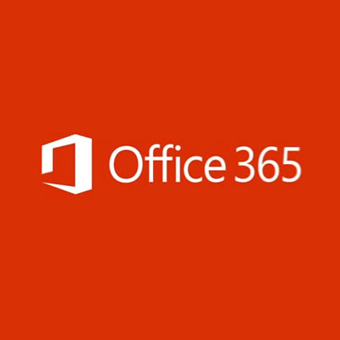
Hybrid Cloud for Your Learning Platform
Your Learning Platform
Host, Migrate & Deploy
Customize & Integrate
Moving to the Cloud doesn’t need to mean moving everything over at the same time. Whether your current Learning Platform is Homegrown, Proprietary, Open Source, or just based on SharePoint On-Prem there’s ways in which you can look to migrate workloads like Virtual Machines, Databases, Load Balancers to Azure.
Similarly, if you’re already leveraging Office 365 or a partner SaaS offering – parts of your Learning Platform can continue to remain on-premises or backed up in your datacenters.
We understand SaaS isn’t always an option. While attractive, it can often be a costly solution and one which forces you to rely entirely on the ISV to update it as your needs evolve.
In many cases with a hybrid cloud model, your Learning Platform can benefit from the same advantages of SaaS Learning Platform giving you the security, scalability and reliability of the cloud – all the while giving you control over where and how your data is stored and the ease to integrate with 3rd party and legacy systems at your own rate.
Open-Source or Proprietary Learning Platform On-Prem
Digital Transformation
Integration with Microsoft Graph
Partially-Hosted on Azure
Fully-Hosted on Azure
SharePoint Server
Migration to Azure
Migration to Office 365
SharePoint Sites Customization & Apps for SharePoint
Backup on Azure or On-Prem
Notes:
Why don’t customers want to self host?
Cost
SaaS solutions can be expensive
Data Governance
ISVs charge more for local hosting
Customizability & Modularity
Easy integration with LOB apps
Evolve platform as use cases mature
Agility
Pilot and scale without relying on a partner
Often have 80% skills in-house
Sales:
First evaluate the customer’s current system – focus on the opportunity to enhance the existing system with Office 365/Azure workloads rather than replace it outright
Migration of SharePoint on-prem is low-hanging fruit as hosting costs can be eliminated with migration to SharePoint Online or reduced through Azure VMs
SharePoint isn’t an out-of-the-box e-Learning solution and shouldn’t be positioned as such. HOWEVER, it can be customized to approximate e-learning functionality
SharePoint can gain customizations through the SharePoint App model
SharePoint customizations can eliminate hosting costs, but long-term are subject to the limitations of the platform. Be sure to position the tradeoffs for customers in any engagement.
Use Azure Media Services, Azure Machine Learning, Power BI, Office Mix, OneNote Classroom /Faculty Notebook Creator and Sway as a complements to legacy e-learning systems – even when hosted on-prem
E-Learning vendors (both proprietary and open source) can integrate their environments with Office 365 workloads. These workloads include: Identity (via Azure Active Directory) and File-Storage (via OneDrive for Business APIs)
When selling open-source e-Learning, partner with official partner where possible

Slide 17

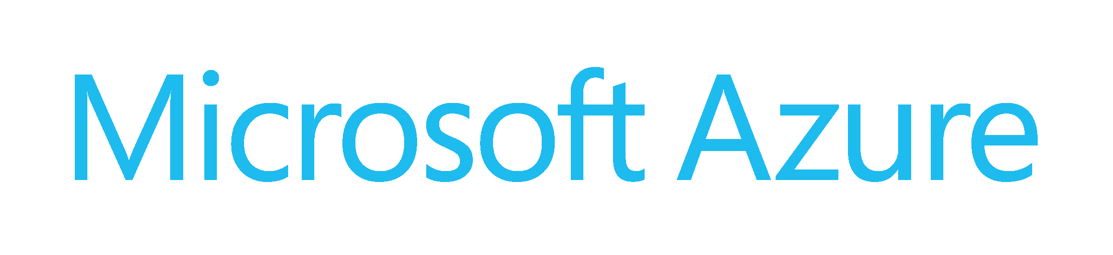



Why Microsoft?
Your Learning Platform
Azure Active Directory Premium
Authentication
User Profiles & Rosters
Registration
Office Groups
School Data Sync
What makes the Microsoft Cloud unique Hybrid Cloud Learning Platform:
Azure Media Services
Azure CDN
Course Video
Office Video
Azure AD B2C and B2B for enabling not only prospective student access, but also guest access from other institutions
Azure Media Services for geographically available video streaming, lecture capture, transcription and indexing
Cortana Intelligence Suite provides end-to-end learner analytics with unparalleled predictive and visualization capabilities
Office 365 and the Microsoft Graph allow you to enhance your learner experience! Students and faculty can:
Login to Learning Platform with their Office 365 account and have 1-click access to Learning Platform directly from Office 365
View Course Calendars in Outlook on any device and keep them in sync
Get access to an OneNote Class Notebook, Shared Inbox, File Storage, and more for your Course
Course Calendars
Exchange Online
Messaging
Skype for Business
Office Groups
Azure Blob Storage
StorSimple
GlusterFS
File Storage & Networking
OneDrive for Business
Content Creation
PowerPoint
Microsoft Forms
Elastic search
Azure Search
Course Search
Azure Machine Learning
Cortana Intelligence Suite
PowerBI
Course Recommendation
Learner Analytics
Dynamics 365
Learner Lifecycle
Recruitment
SQL Azure, MySQL, Maria DB, Clear DB
Database

Slide 18


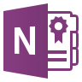
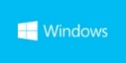
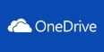
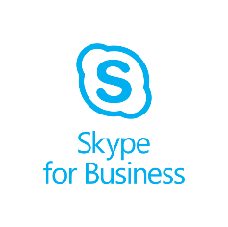


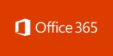






Easy to get started
Immersive Education Experiences
One school identity for students and teachers
Cloud Productivity Platform
Intelligent Cloud & Infrastructure
SDS
AAD Connect
SSO
Connect to existing infrastructure or partner solutions
Microsoft Intune and
Systems Center
OneNote Class Notebook
Learning Tools
Skype
Minecraft
Dynamics CRM Online
Enterprise Mobility Suite
Classroom
Sway
Bing
Kodu
Azure Active Directory
Compliance
Collaboration
Compatibility
Identity
Azure
Analytics
Edge
Touch Develop
HoloLens
Visual Studio
Windows Store
ID and Single Sign on
Management and Security
Device Management
Notes:
Goal of slide: Reiterate that Microsoft is working against a holistic vision for its products & solutions that integrate well together. Close with call to adopt Office 365 Education, Windows 10 and Azure.
Across all of our products and services Microsoft is tying things together in a scalable well that provides immersive education experiences built on top of a cloud productivity platform delivered on a modern O/S, supported by the power of cloud technology that can also be run on-premises.
Today there’s no better way to get started than to:
Try out an app experience like OneNote Class Notebooks or Sway
Signup for Office 365 Education
Upgrade to Windows 10
Trial Azure

Slide 19
Partner opportunities with Azure
Resellers
Breadth (OVS-ES): sell the Monetary Commitment SKU
Depth (EES): sell Azure services from the price list
SIs
Evaluate customer workloads for movement to the cloud
Migrate on premises workloads
ISVs, Content Producers
Move your own workloads to the cloud
Host your content in Azure
Move your solutions to Azure, paid for by customers
Notes:
IGN Pitch IaaS and Azure Certified VMs; discuss save money / increase profits
Different types of partners benefit from Azure in different ways
Azure in EA
AER may sell any SKU on the pricelist
Discount: roughly 10-12% minus AER cut
6, 12 month Commit discounts available (reflected on the price list as separate SKUs)

Slide 20

Questions?

